Slide 1
Natural Language Processing
Lecture 16: Lexical Semantics

Slide 2
The Story Thus Far
So far we have talked about…
  Information extraction
  Morphology
  Language modelling
  Classification
  Syntax and syntactic parsing

Slide 3
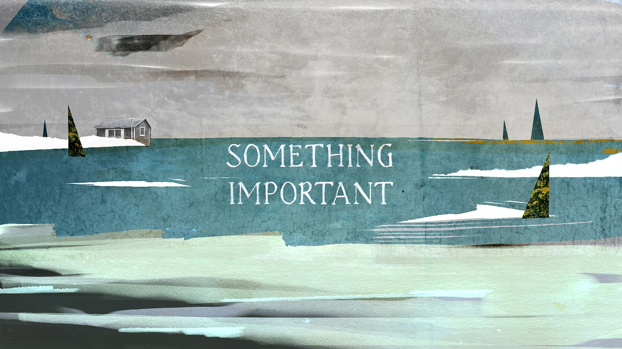
The Path Forward
Now we are going to talk about something that matters

Slide 4
The Path Forward
Semantics (and pragmatics) are the glue that connect language to the real world
In a sense, the other things we have talked about are only meaningful once semantics is taken into account at some level
We will talk about…
  Lexical semantics (the meanings of words)—this lecture
  Word embeddings (a clever way of getting at lexical semantics)
  Model-theoretic semantic representations for sentences
  Semantic parsing and semantic role labelling

Slide 5
Three Ways of Looking at Word Meaning
Decompositional
  What the “components” of meaning “in” a word are
Ontological
  How the meaning of the word relates to the meanings of other words
Distributional
  What contexts the word is found in, relative to other words

Slide 6

Decompositional Semantics

Slide 7
Limitations of Decompositional Semantics
Where do the features come from?
  How do you divide semantic space into features like this?
  How do you settle on a final list?
How do you assign features to words in a principled fashion?
How do you link these features to the real world?
For these reasons, decompositional semantics is the least computationally useful approach to semantics

Slide 8
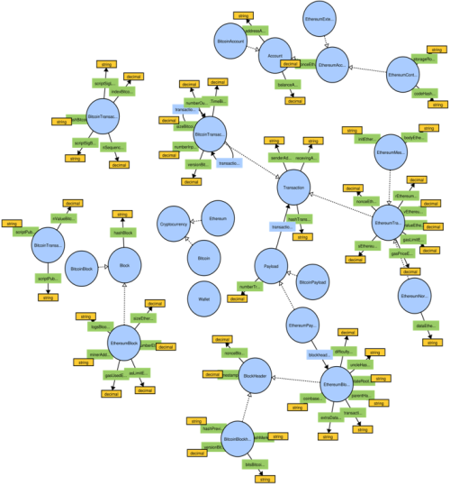
Ontological Approaches to Semantics

Slide 9
Semantic Relations
In grammar school, or in preparation for standardized tests, you may have learned the following terms:
synonymy, antonymy
Synonymy and antonymy are relations between words. They are not alone:
hyponymy, hypernymy, meronymy, holonymy

Slide 10
Semantic Relations
Synonymy—equivalence
  <small, little>
Antonymy—opposition
  <small, large>
Hyponymy—subset; is-a relation
  <dog, mammal>
Hypernymy—superset
  <mammal, dog>
Meronymy—part-of relation
  <liver, body>
Holonymy—has-a relation
  <body, liver>

Slide 11
Lexical Mini-Ontology
holonym (whole)
building.n.1
enclosure.n.1
hypernym
meronymy (has-a)
hypernymy (is-a)
meronym (part)
wall.n.1
fence.n.1
hyponym
door.n.1
antonym
antonymy
antonym
build.v.1
destroy.v.1
wall.v.1
surround.v.2
synonym
synonymy
synonym

Slide 12
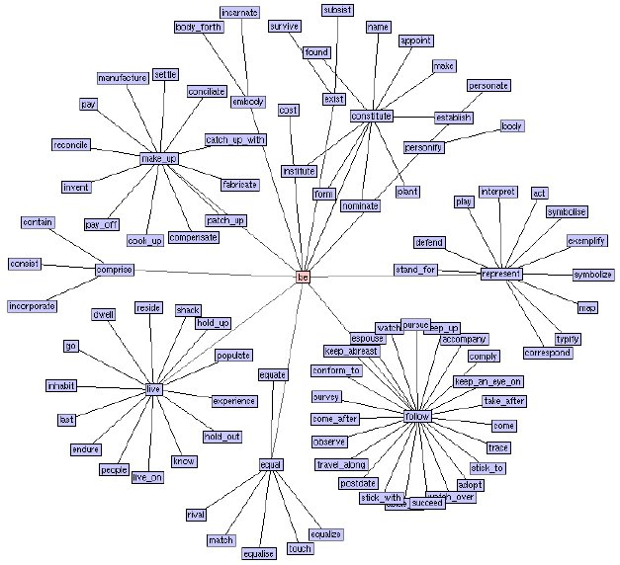
WordNet
WordNet is a lexical resource that organizes words according to their semantic relations

Slide 13
WordNet
Words have different senses
Each of those senses is associated with a synset (a set of words that are roughly synonymous for a particular sense)
These synsets are associated with one another through relations like antonymy, hyponymy, and meronymy

Slide 14
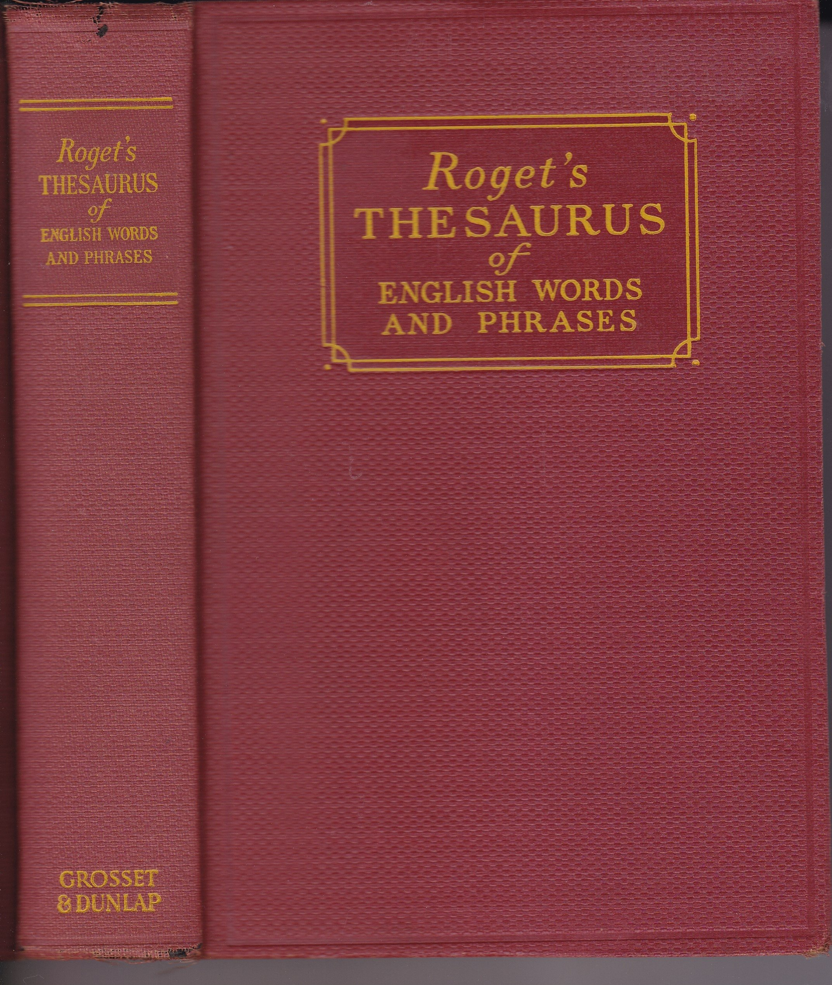
WordNet is a glorified electronic thesaurus

Slide 15
Synsets for dog (n)
S: (n) dog, domestic dog, Canis familiaris (a member of the genus Canis (probably descended from the common wolf) that has been domesticated by man since prehistoric times; occurs in many breeds) "the dog barked all night"
S: (n) frump, dog (a dull unattractive unpleasant girl or woman) "she got a reputation as a frump"; "she's a real dog"
S: (n) dog (informal term for a man) "you lucky dog"
S: (n) cad, bounder, blackguard, dog, hound, heel (someone who is morally reprehensible) "you dirty dog"
S: (n) frank, frankfurter, hotdog, hot dog, dog, wiener, wienerwurst, weenie (a smooth-textured sausage of minced beef or pork usually smoked; often served on a bread roll)
S: (n) pawl, detent, click, dog (a hinged catch that fits into a notch of a ratchet to move a wheel forward or prevent it from moving backward)
S: (n) andiron, firedog, dog, dog-iron (metal supports for logs in a fireplace) "the andirons were too hot to touch"

Slide 16
What’s a Fish?
(According to WordNet)
fish (any of various mostly cold-blooded aquatic vertebrates usually having scales and breathing through gills)
aquatic vertebrate (animal living wholly or chiefly in or on water)
vertebrate, craniate (animals having a bony or cartilaginous skeleton with a segmented spinal column and a large brain enclosed in a skull or cranium)
chordate (any animal of the phylum Chordata having a notochord or spinal column)
animal, animate being, beast, brute, creature, fauna (a living organism characterized by voluntary movement)
organism, being (a living thing that has (or can develop) the ability to act or function independently)
living thing, animate thing (a living (or once living) entity)
whole, unit (an assemblage of parts that is regarded as a single entity)
object, physical object (a tangible and visible entity; an entity that can cast a shadow)
entity (that which is perceived or known or inferred to have its own distinct existence (living or nonliving))

Slide 17
Thesaurus-based Word Similarity
Class Mammalia
Order Artiodactyla
Order Carnivora
Genus Giraffidae
Genus Bovidae
Genus Caniformia
Genus Felidae
giraffe
gazelle
…
lion

Slide 18
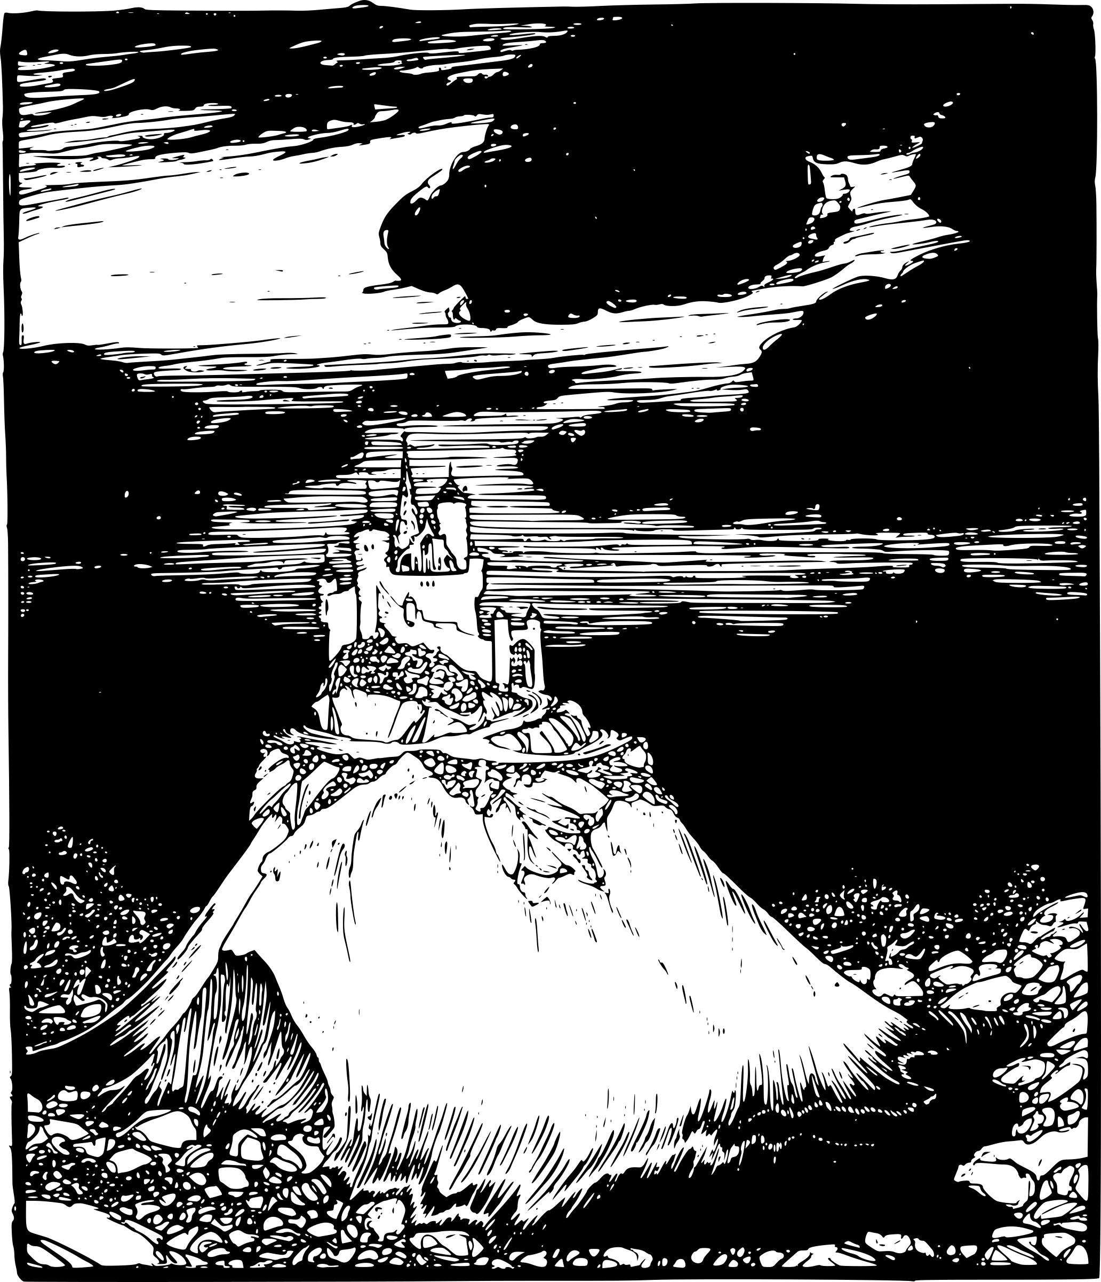

Information Content
# words that are equivalent to or are hyponyms of c
IC(c) = -log
# words in corpus
Entity
0.93
Inanimate-object
1.79
Natural-object
4.12
Geological formation
6.34
Natural-elevation
9.09
Shore
9.39
Hill
10.88
Coast
10.74
(Adapted from Lin. 1998. An information Theoretic Definition of Similarity. ICML.)

Slide 19
WordNet Interfaces
Various interfaces to WordNet are available
  Many languages listed at https://wordnet.princeton.edu/related-projects
  NLTK (Python)
    >>> from nltk.corpus import wordnet as wn
    >>> wn.synsets('dog’)
    (returns list of Synset objects)
    http://www.nltk.org/howto/wordnet.html

Slide 20
Limitations of WordNet and Ontological Semantics
WordNet is a useful resource that many of you will use in your projects
There are intrinsic limits to this type of resource, however:
  It requires many years of manual effort by skilled lexicographers
  In the case of WordNet, some of the lexicographers were not that skilled, and this has led to inconsistencies
  The ontology is only as good as the ontologist(s); it is not driven by data
We will now look at an approach to lexical semantics that is data driven and does not rely on lexicographers

Slide 21
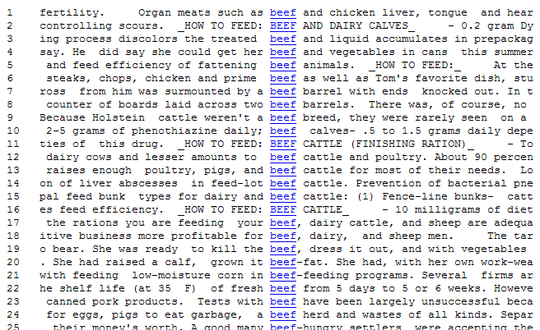
Beef
Sentences from the brown corpus. Extracted from the concordancer in The Compleat Lexical Tutor, http://www.lextutor.ca/

Slide 22
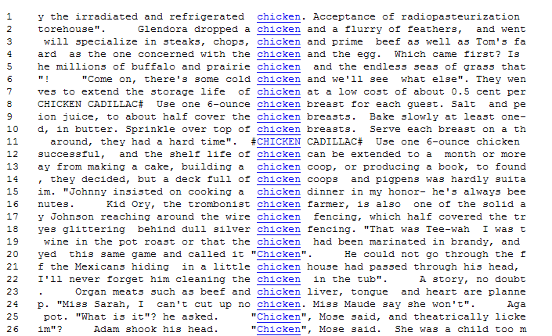
Chicken

Slide 23
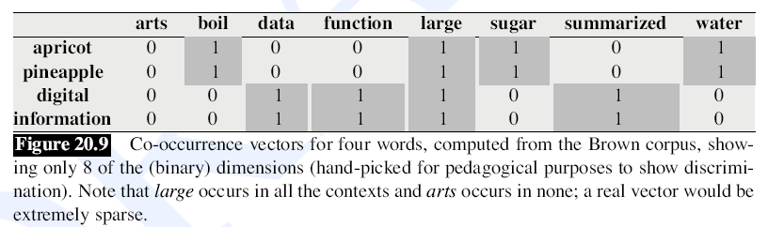
Context Vectors

Slide 24
Hypothetical Counts based on Syntactic Dependencies
 | Modified-by-ferocious(adj) | Subject-of-devour(v) | Object-of-pet(v) | Modified-by-African(adj) | Modified-by-big(adj)
Lion | 15 | 5 | 0 | 6 | 15
Dog | 7 | 3 | 8 | 0 | 12
Cat | 1 | 1 | 6 | 1 | 9
Elephant | 0 | 0 | 0 | 10 | 15
…

Slide 25
A Problem
Some words are going to occur together many times just because they are very frequent
The English words the and is are likely to occur in the same window many times
They may not have a lot to do with one another except for the fact that they are frequent
How should we address this?

Slide 26
Pointwise Mutual Information

Slide 27
Distributionally Similar Words
Rum
vodka
cognac
brandy
whisky
liquor
detergent
cola
gin
lemonade
cocoa
chocolate
scotch
noodle
tequila
juice
Write
read
speak
present
receive
call
release
sign
offer
know
accept
decide
issue
prepare
consider
publish
Ancient
old
modern
traditional
medieval
historic
famous
original
entire
main
indian
various
single
african
japanese
giant
Mathematics
physics
biology
geology
sociology
psychology
anthropology
astronomy
arithmetic
geography
theology
hebrew
economics
chemistry
scripture
biotechnology
(from an implementation of the method described in Lin. 1998. Automatic Retrieval and Clustering of Similar Words. COLING-ACL. Trained on newswire text.)

Slide 28
Questions?

